Slide 1


Slide 2
change nappy

Slide 3
change nappy
plans
prepare infant
prepare nappy
assemble

Slide 4
change nappy
plans
prepare infant
prepare nappy
assemble
goals
strip clothes
clean bum
open
place under
close studs

Slide 5
change nappy
plans
prepare infant
prepare nappy
assemble
goals
strip clothes
clean bum
open
place under
close studs
… /reach X/ /grasp X/ /grasp Y/ /pull Y/ /scoop X/ /Y out of X/ …
motor action

Slide 6
change nappy
plans
prepare infant
prepare nappy
assemble
goals
strip clothes
clean bum
open
place under
close studs
… /reach X/ /grasp X/ /grasp Y/ /pull Y/ /scoop X/ /Y out of X/ …
motor action
… [reach-left-hand X] [left-wholehand-grasp X] [right-wholehand-grasp …

Slide 7
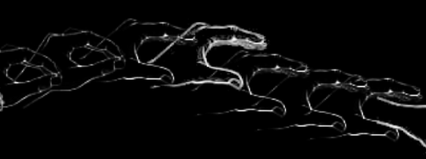
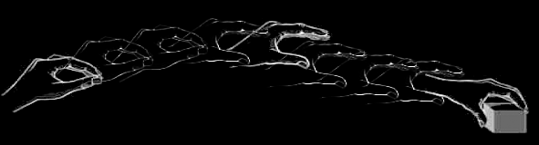
change nappy
plans
prepare infant
prepare nappy
assemble
goals
strip clothes
clean bum
open
place under
close studs
… /reach X/ /grasp X/ /grasp Y/ /pull Y/ /scoop X/ /Y out of X/ …
motor action
… [reach-left-hand X] [left-wholehand-grasp X] [right-wholehand-grasp …
motion
Image adapted from: Rizzolatti, Giacomo, and Giuseppe Luppino. 2001. The Cortical Motor System. Neuron 31, no. 6 (September 27): 889-901. doi:10.1016/S0896-6273(01)00423-8.

Slide 8
change nappy
plans
prepare infant
prepare nappy
assemble
goals
strip clothes
clean bum
open
place under
close studs
… /reach X/ /grasp X/ /grasp Y/ /pull Y/ /scoop X/ /Y out of X/ …
motor action
… [reach-left-hand X] [left-wholehand-grasp X] [right-wholehand-grasp …
motor emulation
motion
Image adapted from: Rizzolatti, Giacomo, and Giuseppe Luppino. 2001. The Cortical Motor System. Neuron 31, no. 6 (September 27): 889-901. doi:10.1016/S0896-6273(01)00423-8.

Slide 9
change nappy
plans
prepare infant
prepare nappy
assemble
goals
strip clothes
clean bum
open
place under
close studs
sequential probabilities
… /reach X/ /grasp X/ /grasp Y/ /pull Y/ /scoop X/ /Y out of X/ …
motor action
… [reach-left-hand X] [left-wholehand-grasp X] [right-wholehand-grasp …
motor emulation
motion
Image adapted from: Rizzolatti, Giacomo, and Giuseppe Luppino. 2001. The Cortical Motor System. Neuron 31, no. 6 (September 27): 889-901. doi:10.1016/S0896-6273(01)00423-8.

Slide 10
change nappy
plans
prepare infant
prepare nappy
assemble
hierarchical patterns
goals
strip clothes
clean bum
open
place under
close studs
sequential probabilities
… /reach X/ /grasp X/ /grasp Y/ /pull Y/ /scoop X/ /Y out of X/ …
motor action
… [reach-left-hand X] [left-wholehand-grasp X] [right-wholehand-grasp …
motor emulation
motion
Image adapted from: Rizzolatti, Giacomo, and Giuseppe Luppino. 2001. The Cortical Motor System. Neuron 31, no. 6 (September 27): 889-901. doi:10.1016/S0896-6273(01)00423-8.

Slide 11
change nappy
plans
prepare infant
prepare nappy
assemble
goals
strip clothes
clean bum
open
place under
close studs
object-directed actions
… /reach X/ /grasp X/ /grasp Y/ /pull Y/ /scoop X/ /Y out of X/ …
… /reach X/ /grasp X/ /grasp Y/
motor action
… [reach-left-hand X] [left-wholehand-grasp X] [right-wholehand-grasp …
motion
Image adapted from: Rizzolatti, Giacomo, and Giuseppe Luppino. 2001. The Cortical Motor System. Neuron 31, no. 6 (September 27): 889-901. doi:10.1016/S0896-6273(01)00423-8.

Slide 12
change nappy
plans
prepare infant
prepare nappy
assemble
goals
strip clothes
clean bum
open
place under
close studs
… /reach X/ /grasp X/ /grasp Y/ /pull Y/ /scoop X/ /Y out of X/ …
motor action
… [reach-left-hand X] [left-wholehand-grasp X] [right-wholehand-grasp …
motion
Image adapted from: Rizzolatti, Giacomo, and Giuseppe Luppino. 2001. The Cortical Motor System. Neuron 31, no. 6 (September 27): 889-901. doi:10.1016/S0896-6273(01)00423-8.

Slide 13


Slide 14

Your field = a set of objects related to you by proximity, orientation, lighting and other factors
You encounter an object = it is in your field
You register an object at a location = you most recently encountered the object at that location

Slide 15
Your field = a set of objects related to you by proximity, orientation, lighting and other factors
You encounter an object = it is in your field
You register an object at a location = you most recently encountered the object at that location
proximity
orientation
lighting
barriers
trajectory

Slide 16
Your field = a set of objects related to you by proximity, orientation, lighting and other factors
You encounter an object = it is in your field
You register an object at a location = you most recently encountered the object at that location
proximity
orientation
lighting
barriers
trajectory

Slide 17
Detour
Goals are not intentions

Slide 18
What is the relation between an action and the goal (or goals) to which it is directed?
out
out
act
out
out

Slide 19
What is the relation between an action and the goal (or goals) to which it is directed?
out
out
act
out
out

Slide 20
What is the relation between an action and the goal (or goals) to which it is directed?
out
out
act
out
intention or other goal-state
out

Slide 21
What is the relation between an action and the goal (or goals) to which it is directed?
teleological function
out
out
act
out
intention or other goal-state
out

Slide 22
(i) in the past, actions of this type have caused outcomes of this type; (ii) this action happens now in part because (i).
What is the relation between an action and the goal (or goals) to which it is directed?
teleological function
out
out
act
out
intention or other goal-state
out

Slide 23
(i) in the past, actions of this type have caused outcomes of this type; (ii) this action happens now in part because (i).
What is the relation between an action and the goal (or goals) to which it is directed?
teleological function
out
out
act
out
intention or other goal-state
It is possible to represent goal-directed actions without representing intentions.
out

Slide 24
End Detour

Slide 25
Your field = a set of objects related to you by proximity, orientation, lighting and other factors
You encounter an object = it is in your field
You register an object at a location = you most recently encountered the object at that location
proximity
orientation
lighting
barriers
trajectory

Slide 26
Your field = a set of objects related to you by proximity, orientation, lighting and other factors
You encounter an object = it is in your field
You register an object at a location = you most recently encountered the object at that location
Principle 3: one can’t goal-directedly act on an object unless one has encountered it.
Principle 2: correct registration is a condition of successful action.
Principle 3: when an agent performs a goal-directed action and the goal specifies an object, the agent will act as if the object were actually in the location she registers it at.
proximity
orientation
lighting
barriers
trajectory

Slide 27
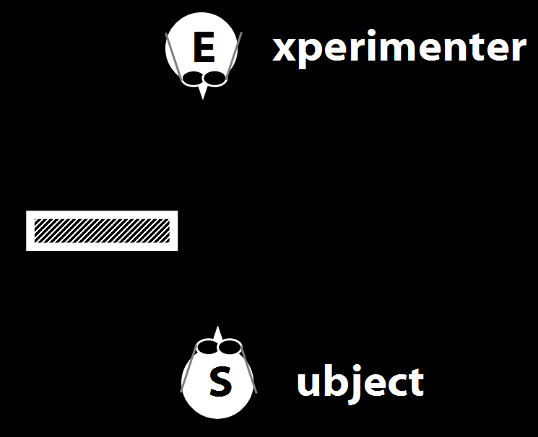
Your field = a set of objects related to you by proximity, orientation, lighting and other factors
You encounter an object = it is in your field
You register an object at a location = you most recently encountered the object at that location
Principle 3: one can’t goal-directedly act on an object unless one has encountered it.
Principle 2: correct registration is a condition of successful action.
Principle 3: when an agent performs a goal-directed action and the goal specifies an object, the agent will act as if the object were actually in the location she registers it at.
proximity
orientation
lighting
barriers
trajectory

Slide 28
Your field = a set of objects related to you by proximity, orientation, lighting and other factors
You encounter an object = it is in your field
You register an object at a location = you most recently encountered the object at that location
Principle 3: one can’t goal-directedly act on an object unless one has encountered it.
Principle 2: correct registration is a condition of successful action.
Principle 3: when an agent performs a goal-directed action and the goal specifies an object, the agent will act as if the object were actually in the location she registers it at.
“children could … think about what the other person saw rather than what they saw”
(Flavell, Shipstead & Croft 1978: 1210)
proximity
orientation
lighting
barriers
trajectory

Slide 29
Your field = a set of objects related to you by proximity, orientation, lighting and other factors
You encounter an object = it is in your field
You register an object at a location = you most recently encountered the object at that location
Principle 3: one can’t goal-directedly act on an object unless one has encountered it.
Principle 2: correct registration is a condition of successful action.
Principle 3: when an agent performs a goal-directed action and the goal specifies an object, the agent will act as if the object were actually in the location she registers it at.
“children could … think about what the other person saw rather than what they saw”
(Flavell, Shipstead & Croft 1978: 1210)
“children could … think about what the other person saw rather than what they saw”
(Flavell, Shipstead & Croft 1978: 1210)
proximity
orientation
lighting
barriers
trajectory

Slide 30
Your field = a set of objects related to you by proximity, orientation, lighting and other factors
You encounter an object = it is in your field
You register an object at a location = you most recently encountered the object at that location
Principle 3: one can’t goal-directedly act on an object unless one has encountered it.
Principle 2: correct registration is a condition of successful action.
Principle 3: when an agent performs a goal-directed action and the goal specifies an object, the agent will act as if the object were actually in the location she registers it at.
proximity
orientation
lighting
barriers
trajectory

Slide 31
Your field = a set of objects related to you by proximity, orientation, lighting and other factors
You encounter an object = it is in your field
You register an object at a location <= you most recently encountered the object at that location
Principle 3: one can’t goal-directedly act on an object unless one has encountered it.
Principle 2: correct registration is a condition of successful action.
Principle 3: when an agent performs a goal-directed action and the goal specifies an object, the agent will act as if the object were actually in the location she registers it at.
proximity
orientation
lighting
barriers
trajectory

Slide 32
Your field = a set of objects related to you by proximity, orientation, lighting and other factors
You encounter an object = it is in your field
You register an object at a location = you most recently encountered the object at that location
Principle 3: one can’t goal-directedly act on an object unless one has encountered it.
Principle 4: correct registration is a condition of successful action.
Principle 3: when an agent performs a goal-directed action and the goal specifies an object, the agent will act as if the object were actually in the location she registers it at.
proximity
orientation
lighting
barriers
trajectory

Slide 33
source: Liszkowski et al (2008)

Slide 34
source: Liszkowski et al (2008)

Slide 35
source: Liszkowski et al (2008)

Slide 36
source: Liszkowski et al (2008)

Slide 37
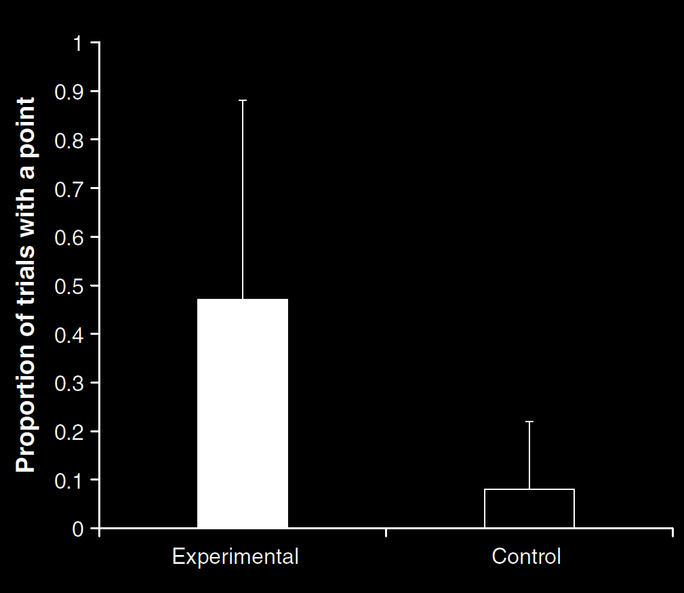
Your field = a set of objects related to you by proximity, orientation, lighting and other factors
You encounter an object = it is in your field
You register an object at a location <= you most recently encountered the object at that location
Principle 3: one can’t goal-directedly act on an object unless one has encountered it.
Principle 4: correct registration is a condition of successful action.
Principle 3: when an agent performs a goal-directed action and the goal specifies an object, the agent will act as if the object were actually in the location she registers it at.
source: Liszkowski et al (2008)
proximity
orientation
lighting
barriers
trajectory

Slide 38
Your field = a set of objects related to you by proximity, orientation, lighting and other factors
You encounter an object = it is in your field
You register an object at a location = you most recently encountered the object at that location
Principle 3: one can’t goal-directedly act on an object unless one has encountered it.
Principle 4: correct registration is a condition of successful action.
Principle 3: when an agent performs a goal-directed action and the goal specifies an object, the agent will act as if the object were actually in the location she registers it at.
“Helping by informing inextricably involves … an understanding of others’ goals and … of others’ ignorance.”
(Liszkowski, Carpenter & Tomasello 2008: 738-9)
source: Liszkowski et al (2008)
proximity
orientation
lighting
barriers
trajectory

Slide 39
Your field = a set of objects related to you by proximity, orientation, lighting and other factors
You encounter an object = it is in your field
You register an object at a location = you most recently encountered the object at that location
Principle 3: one can’t goal-directedly act on an object unless one has encountered it.
Principle 4: correct registration is a condition of successful action.
Principle 3: when an agent performs a goal-directed action and the goal specifies an object, the agent will act as if the object were actually in the location she registers it at.
“Helping by informing inextricably involves … an understanding of others’ goals and … of others’ ignorance.”
(Liszkowski, Carpenter & Tomasello 2008: 738-9)
“Helping by informing inextricably involves … an understanding of others’ goals and … of others’ ignorance.”
(Liszkowski, Carpenter & Tomasello 2008: 738-9)
source: Liszkowski et al (2008)
proximity
orientation
lighting
barriers
trajectory

Slide 40
Your field = a set of objects related to you by proximity, orientation, lighting and other factors
You encounter an object = it is in your field
You register an object at a location <= you most recently encountered the object at that location
Principle 3: one can’t goal-directedly act on an object unless one has encountered it.
Principle 4: correct registration is a condition of successful action.
Principle 3: when an agent performs a goal-directed action and the goal specifies an object, the agent will act as if the object were actually in the location she registers it at.
proximity
orientation
lighting
barriers
trajectory

Slide 41
Your field = a set of objects related to you by proximity, orientation, lighting and other factors
You encounter an object = it is in your field
You register an object at a location <= you most recently encountered the object at that location
Principle 3: one can’t goal-directedly act on an object unless one has encountered it.
Principle 4: correct registration is a condition of successful action.
Principle 5
proximity
orientation
lighting
barriers
trajectory

Slide 42
Your field = a set of objects related to you by proximity, orientation, lighting and other factors
You encounter an object = it is in your field
You register an object at a location <= you most recently encountered the object at that location
Principle 3: one can’t goal-directedly act on an object unless one has encountered it.
Principle 4: correct registration is a condition of successful action.
Principle 5: when an agent performs a goal-directed action and the goal specifies an object, the agent will act as if the object were actually in the location she registers it at.
proximity
orientation
lighting
barriers
trajectory

Slide 43
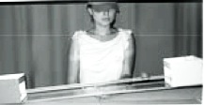
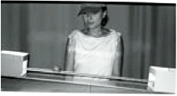
source Träuble, Marinovic, & Pauen (2010)

Slide 44
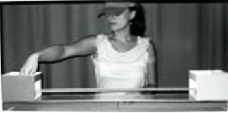
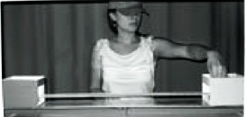
source Träuble, Marinovic, & Pauen (2010)

Slide 45
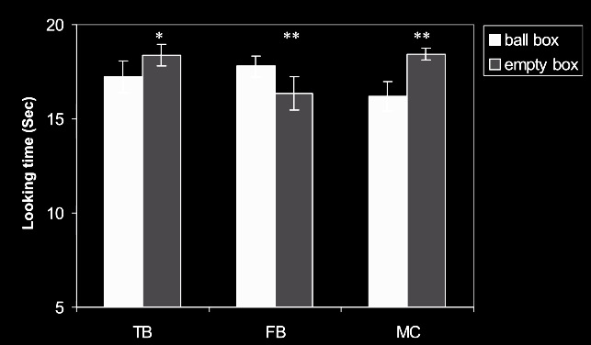
source Träuble, Marinovic, & Pauen (2010)

Slide 46
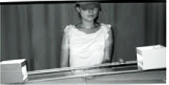
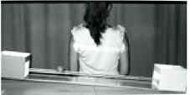
source Träuble, Marinovic, & Pauen (2010)

Slide 47
source Träuble, Marinovic, & Pauen (2010)

Slide 48
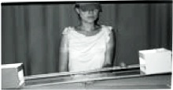
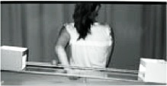
source Träuble, Marinovic, & Pauen (2010)

Slide 49
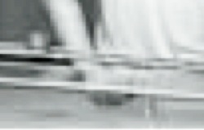
source Träuble, Marinovic, & Pauen (2010)

Slide 50
source Träuble, Marinovic, & Pauen (2010)

Slide 51
Your field = a set of objects related to you by proximity, orientation, lighting and other factors
You encounter an object = it is in your field
You register an object at a location <= you most recently encountered the object at that location
Principle 3: one can’t goal-directedly act on an object unless one has encountered it.
Principle 4: correct registration is a condition of successful action.
Principle 5: when an agent performs a goal-directed action and the goal specifies an object, the agent will act as if the object were actually in the location she registers it at.
proximity
orientation
lighting
barriers
trajectory

Slide 52
Your field = a set of objects related to you by proximity, orientation, lighting and other factors
You encounter an object = it is in your field
You register an object at a location <= you most recently encountered the object at that location
Principle 3: one can’t goal-directedly act on an object unless one has encountered it.
Principle 4: correct registration is a condition of successful action.
Principle 5: when an agent performs a goal-directed action and the goal specifies an object, the agent will act as if the object were actually in the location she registers it at.
proximity
orientation
lighting
barriers
trajectory

Slide 53
Principle 4: correct registration is a condition of successful action.
source Träuble, Marinovic, & Pauen (2010)

Slide 54


